Slide 1


APPLE TRADING STOCKS
Jay Nirmal Lipeng Hao Vrushali Bandale Abhishek Mendon Saumil shah

Slide 2

AGENDA
Overview
History
Problems to Solve
Project Objective
Trading Strategies
Proposed Solutions
Random Forest Implementations
Improvements

Slide 3
OVERVIEW

Slide 4
Apple (ticker symbol: AAPL) is one of the world's leading consumer electronics and personal computer companies. Apple focuses on developing its own hardware, software, operating systems and services to provide its customers with the best user experience possible.
They have continued to focus on personal computers for the following decades, but in recent years that focus has shifted more to consumer electronics such as the iPhone, iPad and iPod. However, Apple also sells a range of related software, services and applications, with some of the most prominent non-electronics products being the iCloud, iOS, Mac OS and Apple TV.
Despite Apple's market-leading position, the company still faces a number of risk factors, which include changing global economic conditions, fluctuating consumer demand, worldwide-competition and potential supply chain disruptions.

Slide 5

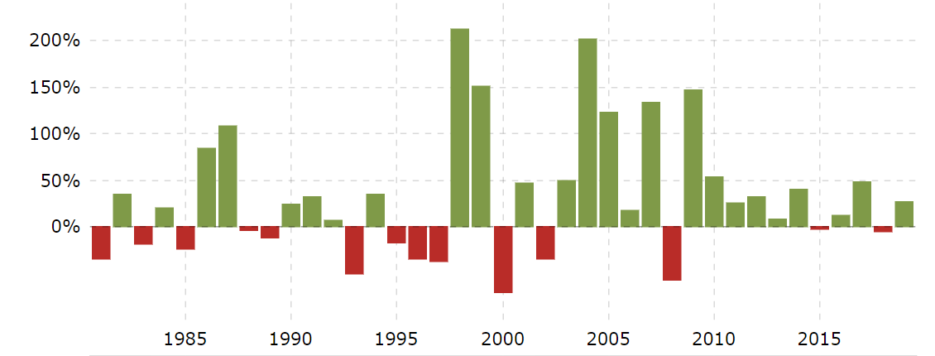

HISTORY
1985: Steve Jobs left Apple
Jobs was ousted by the board of directors in an apparent coup. The company’s leadership instability resulted in the stock falling to below $2 per share.
1998: The first iMac is unveiled.
Jobs introduced the colorful and translucent desktop less than a year after he returned to the company.
2007: The iPhone debuts.
The mobile device signaled the beginning of the mobile revolution. The iPhone was the best-selling tech product in 2017, ten years after its launch, USA Today reported.

Slide 6
PROBLEMS TO SOLVE
Exploratory Data Analysis of apple stock data to figure out parameters to create machine learning models.
Developing different machine learning algorithms to predict stock prices.
Creating Random forest to optimize our models and get the optimal results.
Creating Investment Strategies for trading our stocks using predicted stock price to get the return on investment and other parameters.

Slide 7
PROJECT OBJECTIVE
The art of forecasting stock prices has been a difficult task for many of the researchers and analysts. In fact, investors are highly interested in the research area of stock price prediction.
For a good and successful investment, many investors are keen on knowing the future situation of the stock market. Good and effective prediction systems for stock market help traders, investors, and analyst by providing supportive information like the future direction of the stock market.
In this work, we present a Regression models and Long Short-Term Memory (LSTM) approach to predict stock market indices. Using those we will produce investment return using our trading strategy to complete our portfolio.

Slide 8
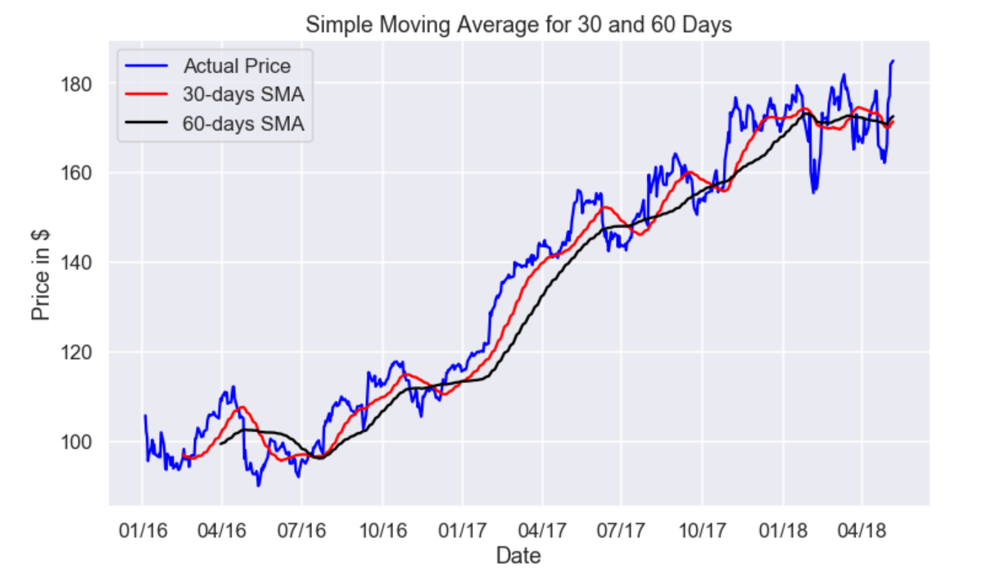
MOVING AVERAGE
Simple Moving Average Strategy SMA is one of the simplest trading strategies. As the name implies this technique uses a rolling average of 'D' days and 'D-1' days are not taken into consideration as they are used for calculation. So, if we calculate a 5 days moving average the 1st 4 days value will not be considered.

Slide 9
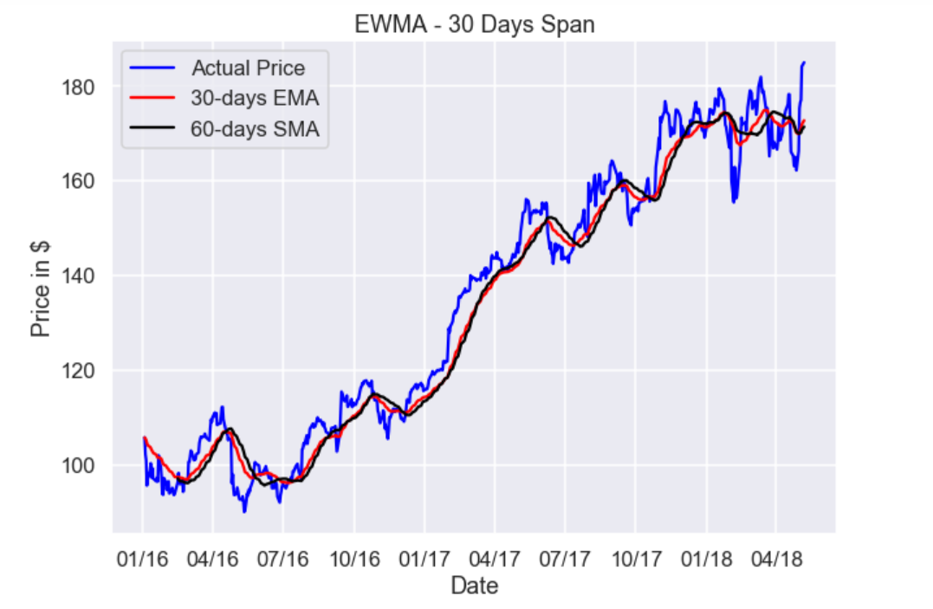
EXPONENTIAL MOVING AVERAGE
Exponential Moving Average is a weighted moving average(WMA) that gives more weighting or importance to recent price data than the simple moving average

Slide 10
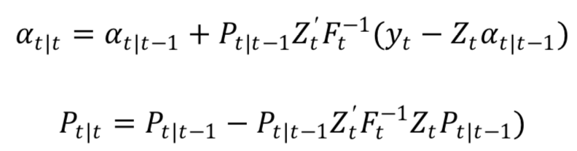
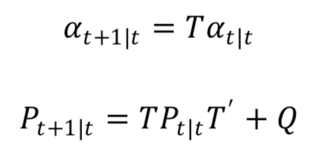
KALMAN FILTER
The Kalman Filter allows inference to be done in the basic state space model. In this model, 𝑎𝑎𝑡𝑡|𝑌𝑌𝑠𝑠 is normal; let 𝛼𝛼𝑡𝑡|𝑠𝑠 and 𝑃𝑃𝑡𝑡|𝑠𝑠 denote its mean and variance.
Updating Equations:
Prediction Equations:
R2 Value: 6.276721282534837

Slide 11
The algorithm works in a two-step process. In the prediction step, the Kalman filter produces estimates of the current state variables, along with their uncertainties. Once the outcome of the next measurement (necessarily corrupted with some amount of error, including random noise) is observed, these estimates are updated using a weighted average, with more weight being given to estimates with higher certainty.
The algorithm is recursive. It can run in real time, using only the present input measurements and the previously calculated state and its uncertainty matrix; no additional past information is required.

Slide 12
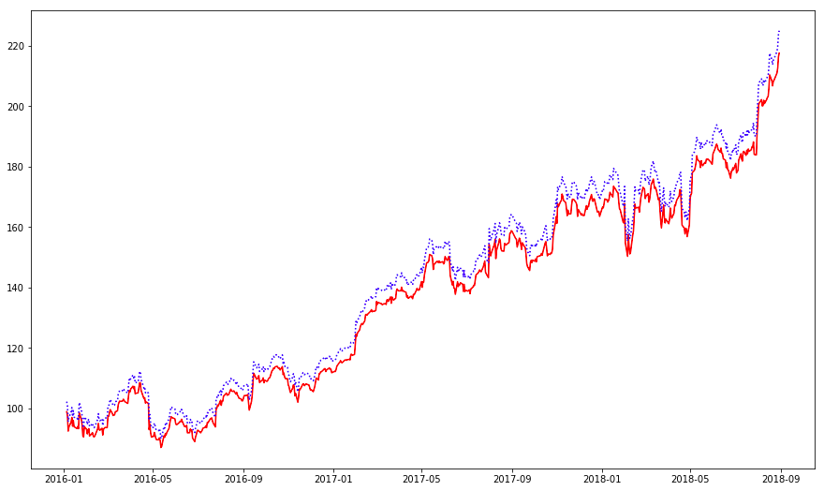
GRAPHICAL REPRESENTATION OF KALMAN FILTER
RMSE: 6.026482

Slide 13
LSTM(LONG SHORT TERM MEMORY)
An Artificial RNN used in the field of deep learning.
Well-suited to classifying, processing and making predictions based on time series data, since there can be lags of unknown duration between important events in a time series.
LSTM unit is composed of a cell, an input gate, an output gate and a forget gate.
Makes small modifications to the information by multiplications and additions.

Slide 14
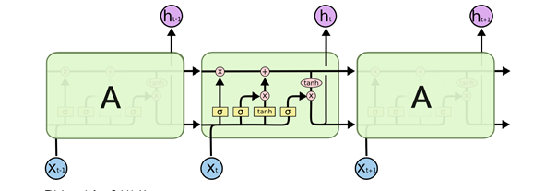
LSTM networks are well-suited to classifying, processing and making predictions based on time series data, since there can be lags of unknown duration between important events in a time series.
LSTMs were developed to deal with the exploding and vanishing gradient problems that can be encountered when training traditional RNNs.

Slide 15
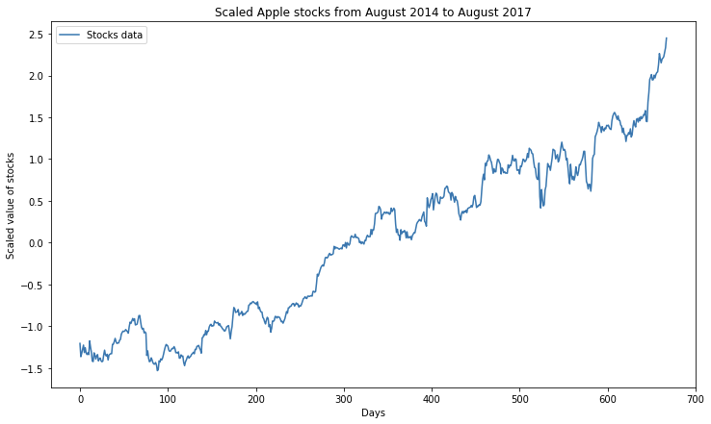
LSTM PREDICTION
Scaling the Input Dataset
Transforming Train and Test Data to Vector form for calculating weights.

Slide 16
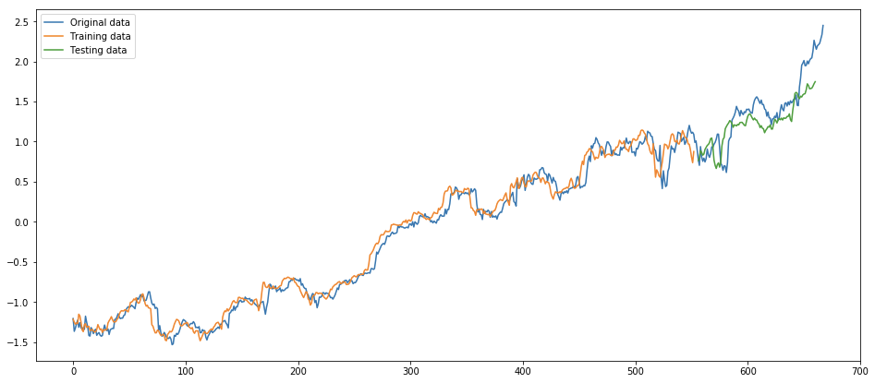
LSTM PREDICTION
RMSE Value: 8.96486926940371

Slide 17
RANDOM FOREST STRUCTURE
Train on Each models
Compare R square
Keep the Best model and result
Average results
Bootstrap N samples

Slide 18
WHAT IS RANDOM FOREST
Random forests or random decision forests are an ensemble learning method for classification, Regression and other tasks that operates by constructing a multitude of decision tree at training time and outputting the class that is the mode of the classes (classification) or mean prediction (regression) of the individual trees. Random decision forests correct for decision trees' habit of overfitting to their training set.

Slide 19
BOOTSTRAP AND RANDOM FOREST PREDICTION
Implemented Random Forest on 3 models
Fama French
‘Mkt-FR’, 'SMB', 'HML'
Stock itself Model
'Open', 'High', 'Low', 'Close', 'Volume', 'ADS_Index', 'SP500'
Company Model
'AMZN', 'FB', 'GOOGL', 'NFLX', 'NVDA', 'TSLA'

Slide 20
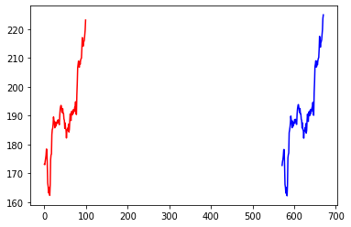
Random Forest Result

Slide 21
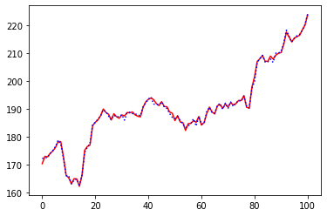
Random Forest Prediction

Slide 22
TRADING STRATEGY 1(Random Forest)
Compare the Open price and Predicted Close price.
If Open < Predicted Price:
We Purchase it and sell it at the closing price.
.
Otherwise we won’t trade.
Assuming we have 1 unit money to invest
The return rate is: 8.4 % for the past 100 days.

Slide 23
TRADING STRATEGY 2(BOLLINGER BANDS)
BB are used to determine overbought and oversold levels, where a trader will try to sell when the price reaches the top of the band and will execute a buy when the price reaches the bottom of the band.
The BB has 3 components:
Middle line which is The 20 day simple moving average of the closing prices
An upper band – this is the +2 standard deviation of the middle line
A lower band – this is the -2 standard deviation of the middle line

Slide 24
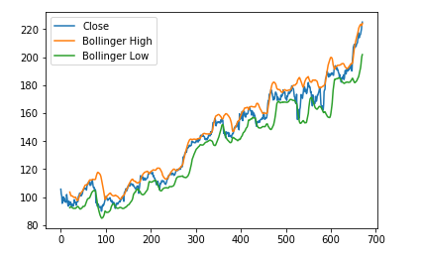

Investment Results:
The Sharpe Ratio for Bollinger band came out to be 2.62

Slide 25
Investment Results
●﻿Assuming we have initially bought shares at price $170 per share with half of our initial investment.
●Assuming we have $100000.0 to invest using Strategy 1, based on the approximate price of $170 per share, then we can help you earn $130434.78.
●The return rate is: 30% past 100 days

Slide 26
PROPOSED SOLUTION
Using Random Forest could gather advantages of different models.
Linear Regression can get good results, but still not precise enough.
The machine learning method can beat the bank at least.
If the investor wants a stable and less risky investment then they should go with Bollinger Bands and if they are looking for high return and have the guts to take the risk, they can choose day trading.
Don’t trust a quant, their performance is worse than a stone!

Slide 27
IMPROVEMENTS
Expand stock data to improve our results.
Use Deep Learning algorithms to improve our prediction.
Contain more than one stocks as a investment combination.
More understandability of Trading Strategies to produce real-time returns.

Slide 28
THANK YOU!!

